Slide 1
Data-Driven Sales Growth Strategic Plan for Superstore
November 2024

Slide 2
Data Scenario
Company Background: A retail chain, SuperStore, sells various consumer products across multiple states in the U.S.
Dataset Overview: The dataset contains detailed transaction records from SuperStore from 2014 - 2017. The columns in the dataset include:
Order Date: Date of each order.
Customer Information: Customer ID, customer name, segment, and region.
Product Information: Product category (Technology, Furniture, Office Supplies), sub-category, product ID, and product name.
Sales and Financials: Sales amount, profit, discount applied, and quantity ordered.
2

Slide 3
Big Question
Which is the most profitable Product line in the Superstore?
How can the Superstore strategically maximise profitability?
3

Slide 4

Overview of the analysis
Target Audience
Sales & Marketing managers
Metric
Sales and Profit
Flow of analysis
Product category
Sub-category
Profitable product line
Recommendations
4

Slide 5
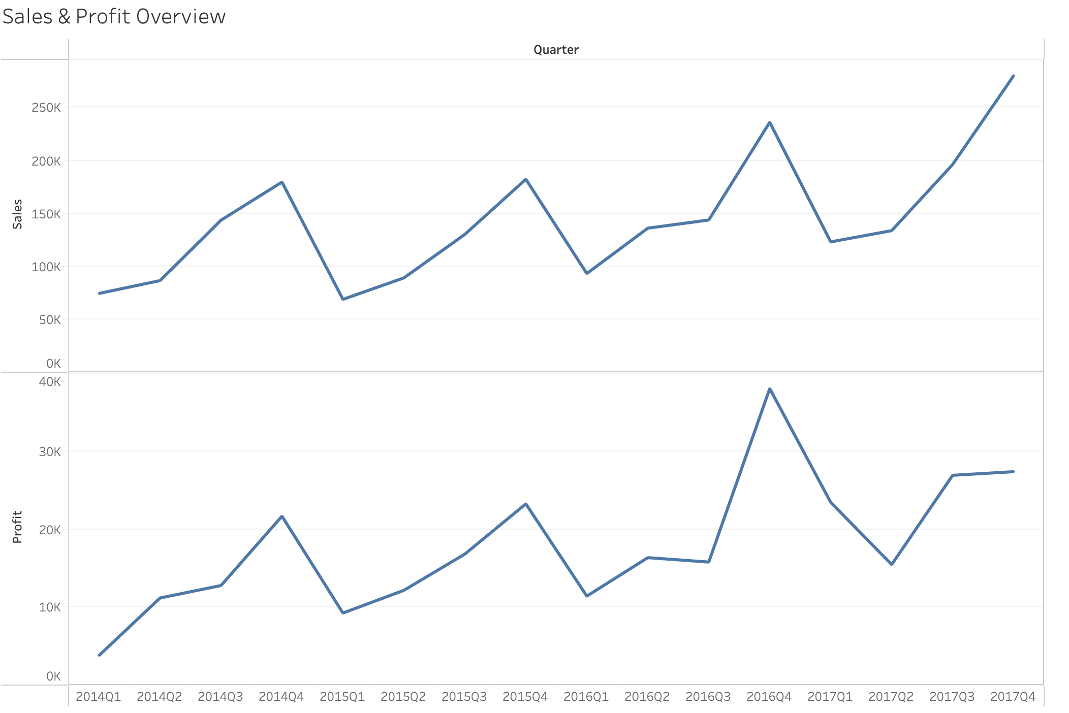
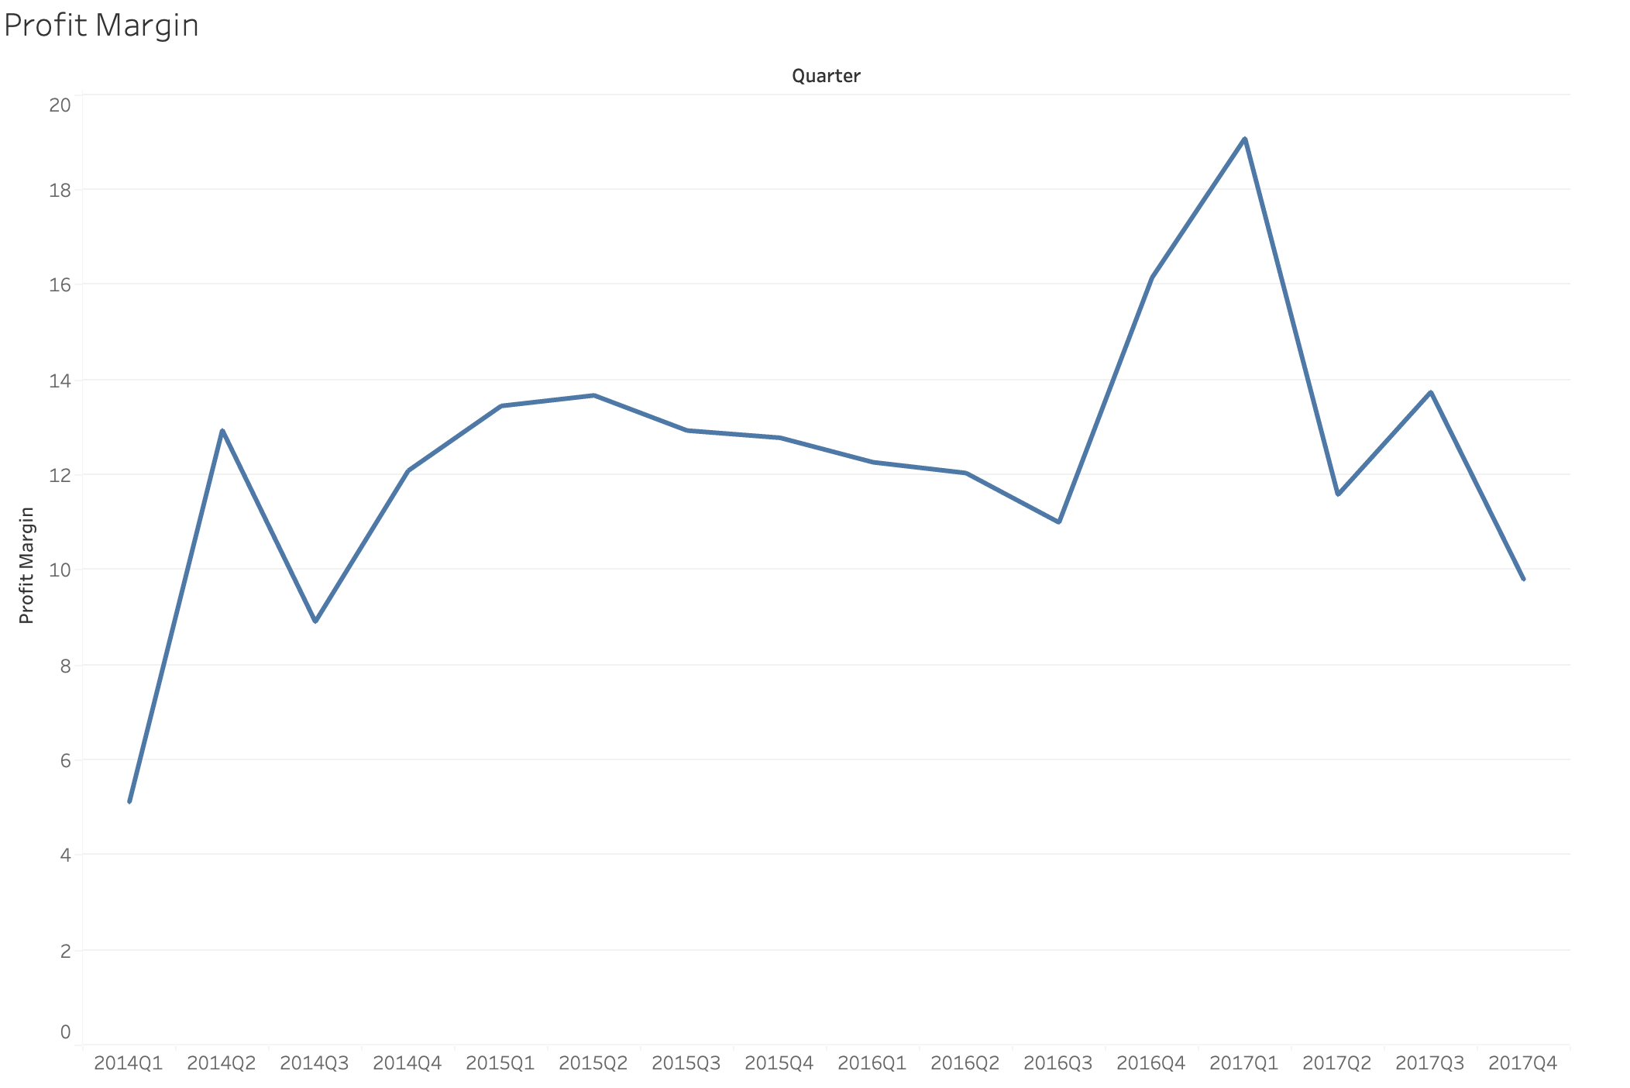
Sales and Profit Overview
2021
17%
2022
14%
The Superstore's business performance seems consistent, with profits and revenue increasing together, indicating that operating costs are well-managed.
5

Slide 6
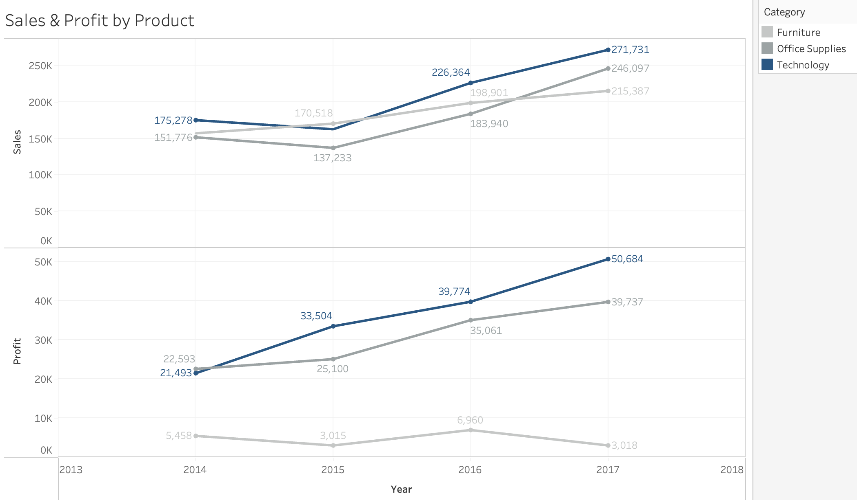
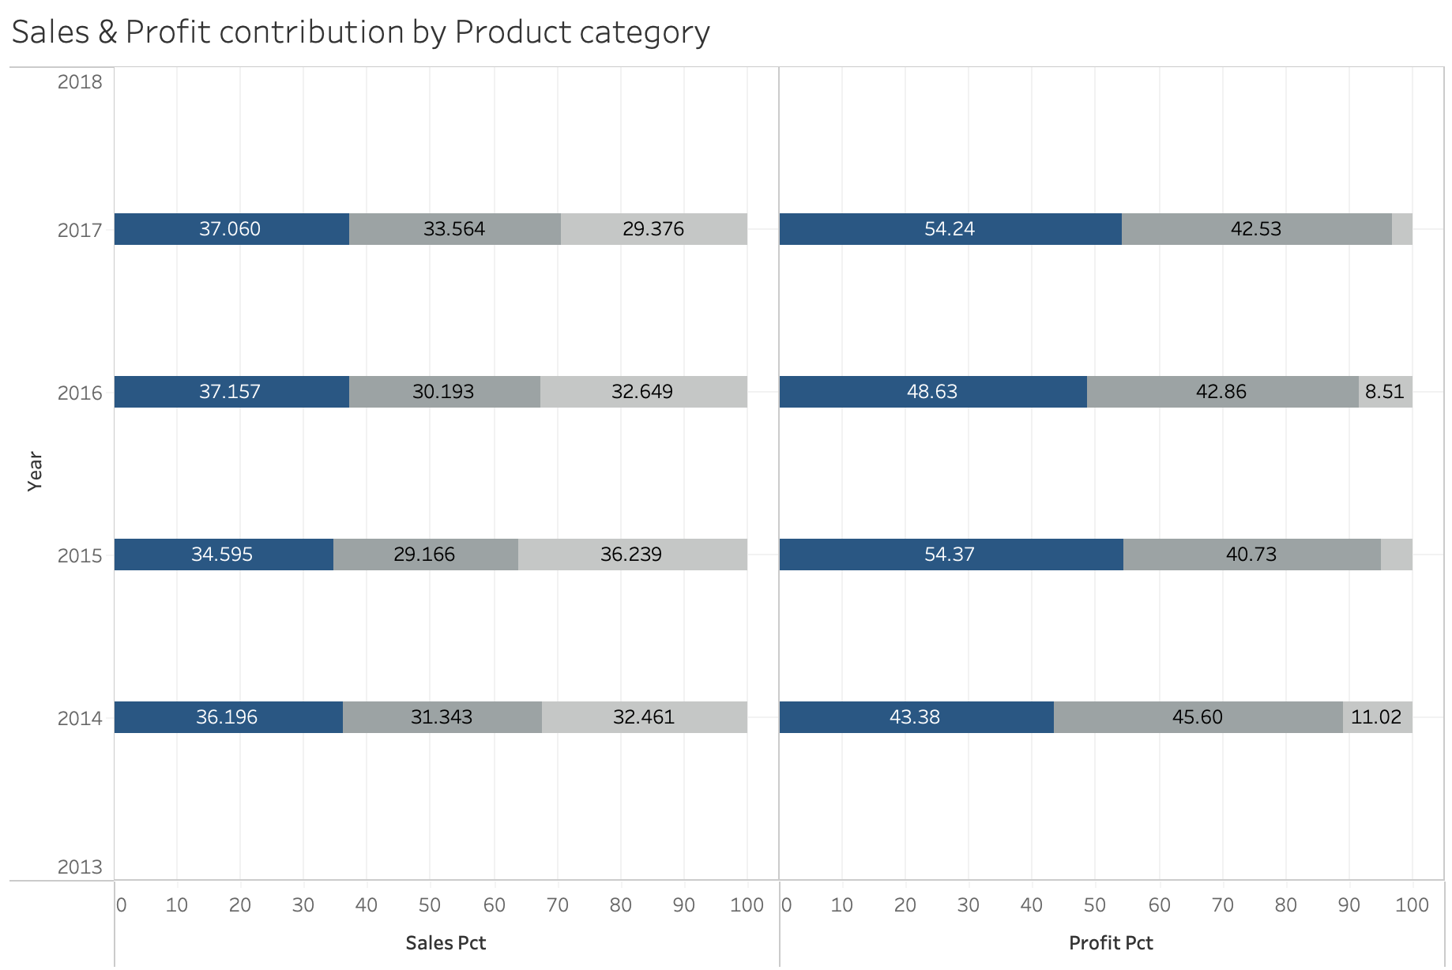
Sales and Profit by Product category
Although the revenue contributions of the three categories are relatively balanced, Technology generates the highest profit proportion, followed by Office Supplies, with Furniture having the lowest profit proportion.
This report will analyze the Technology category in detail, as it is the largest contributor to overall profit.
6

Slide 7

Sales and Profit by Technology’s Sub-category Analysis
7

Slide 8
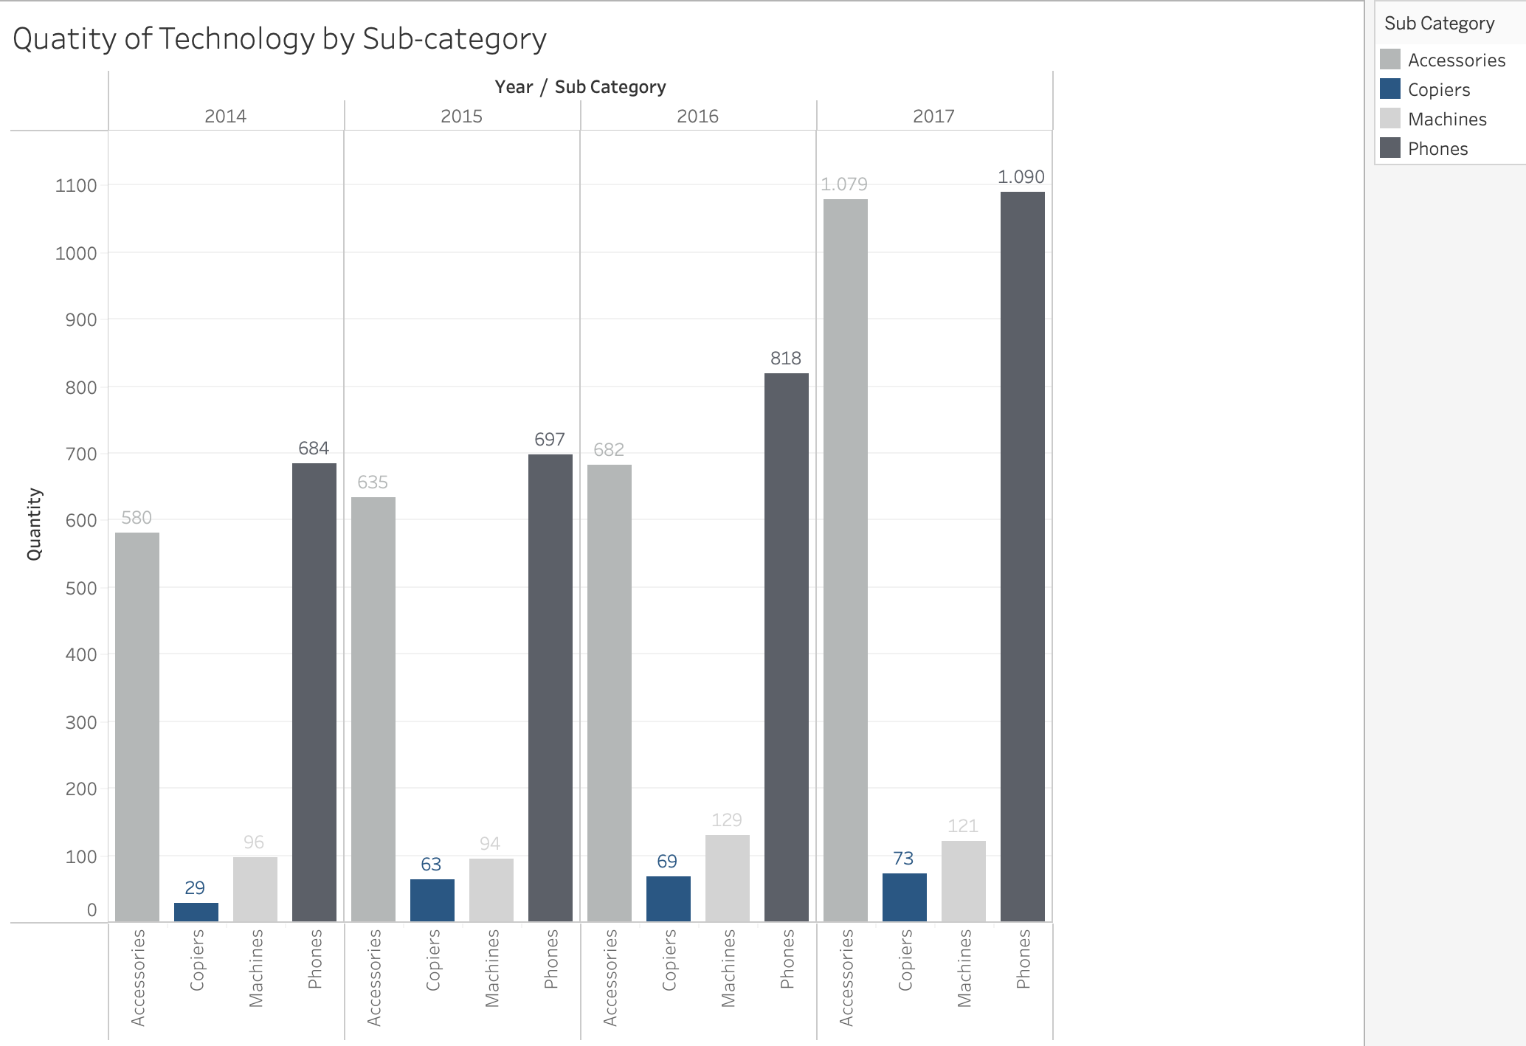
Although Copiers are sold in much smaller quantities than the Phones category, they yield the highest profit for Superstore. This indicates that Copiers is a product line with a long lifecycle and high investment value.
8

Slide 9
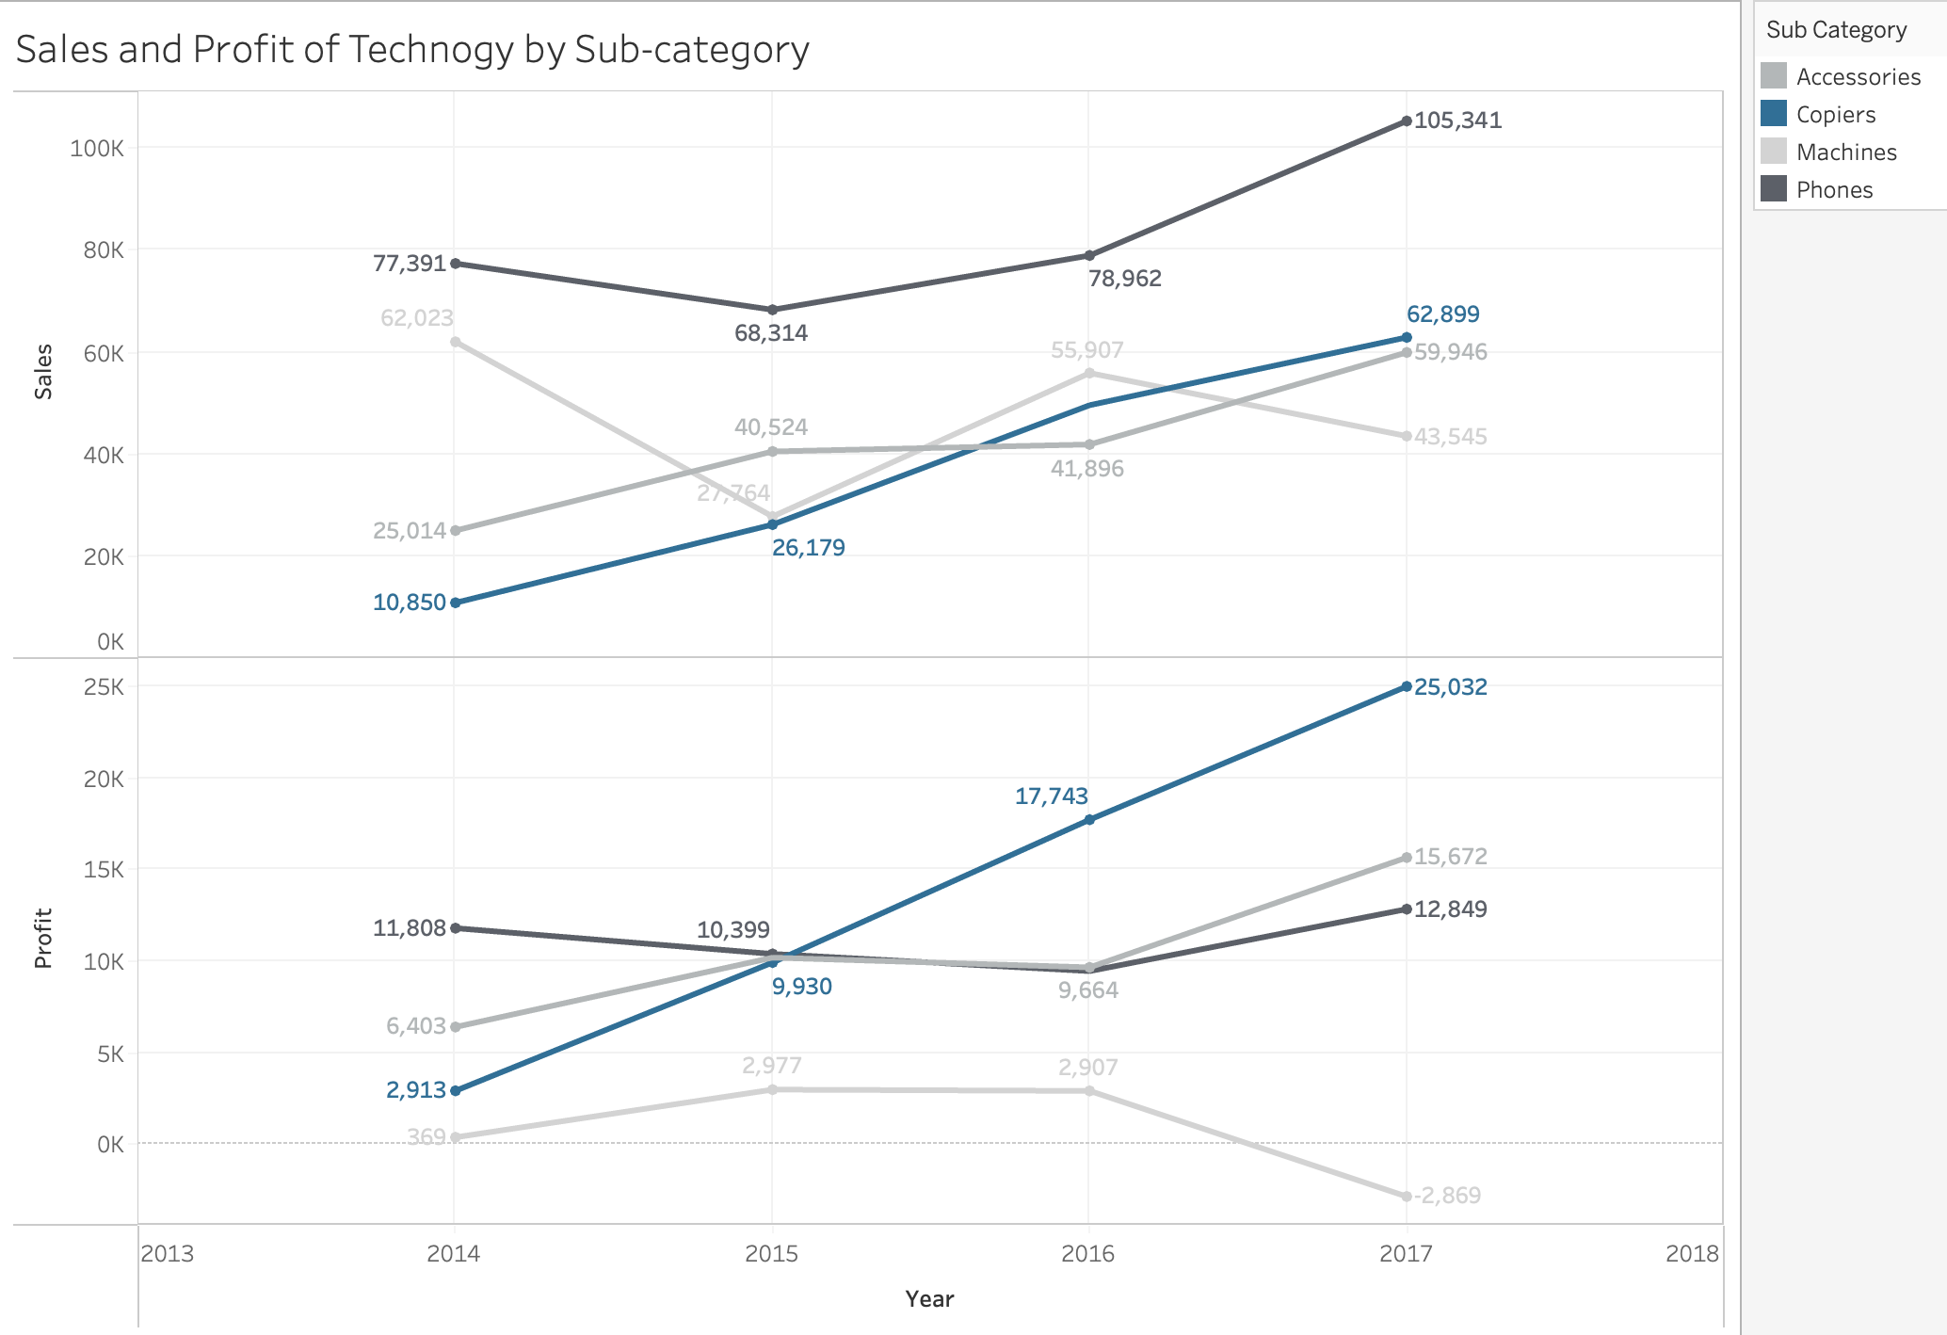
While the Phones segment has the highest sales, it does not generate the highest profit. However, Copiers show a consistent increase in sales year over year and has become the top contributor to profit.
We will now focus exclusively on the Copiers segment to get a more detailed understanding of Copiers' performance and characteristics.
9

Slide 10

Copiers’ Sales and Profit Analysis
10

Slide 11
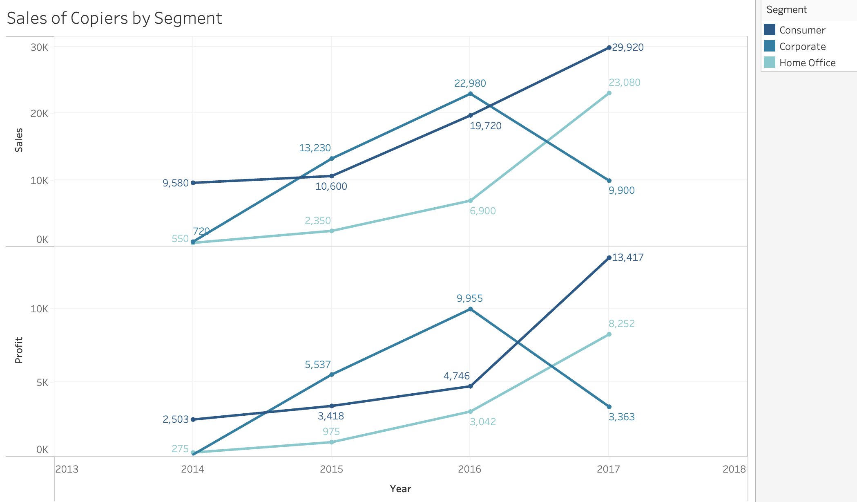
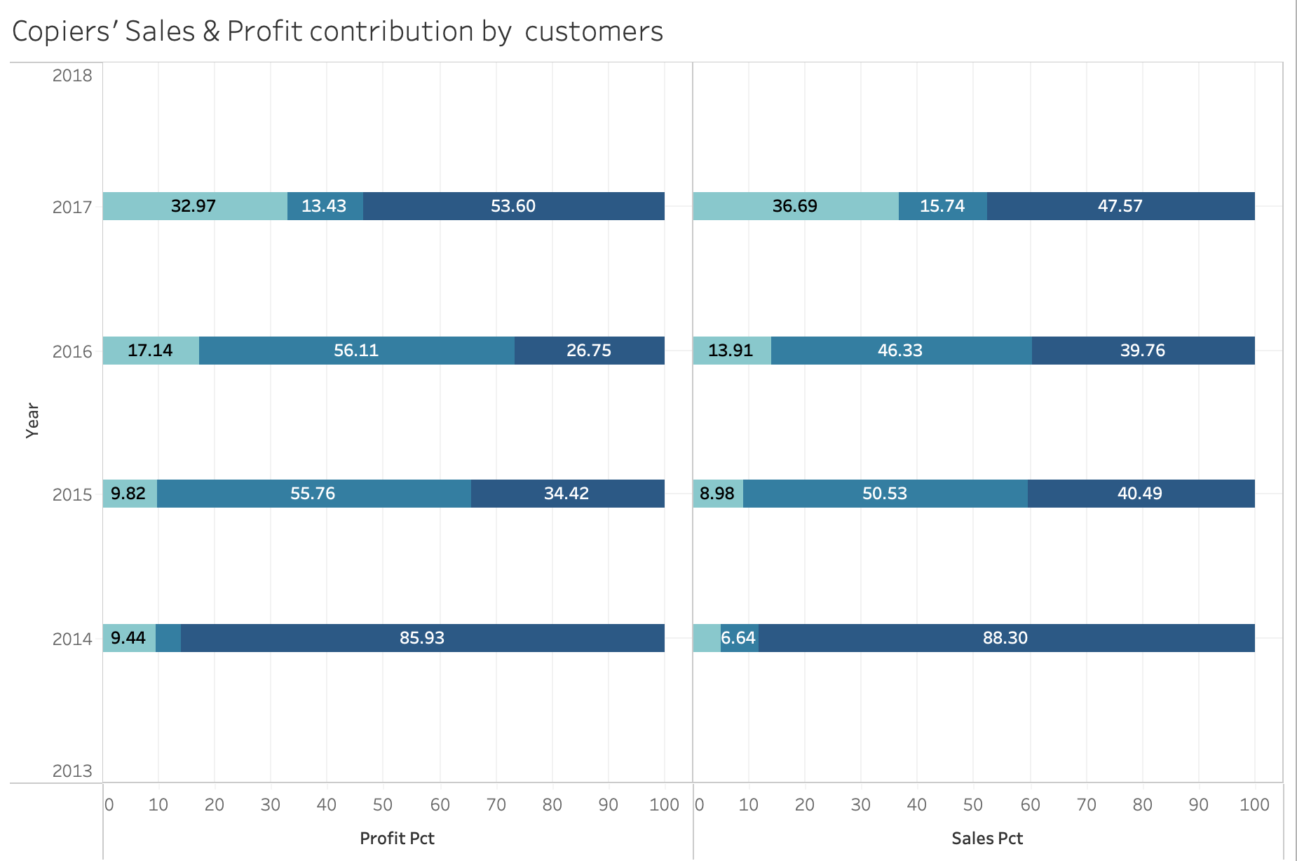
Consumer: Shows steady growth in revenue and profit, especially between 2016 and 2017, making it the largest contributor to Copier sales.
Corporate: Experienced strong revenue growth from 2014 to 2016, with a slight decrease in 2017. While it has high potential, profit growth has been inconsistent with year-to-year fluctuations.
Home Office: A potential market with strong sales growth in 2017.
11

Slide 12
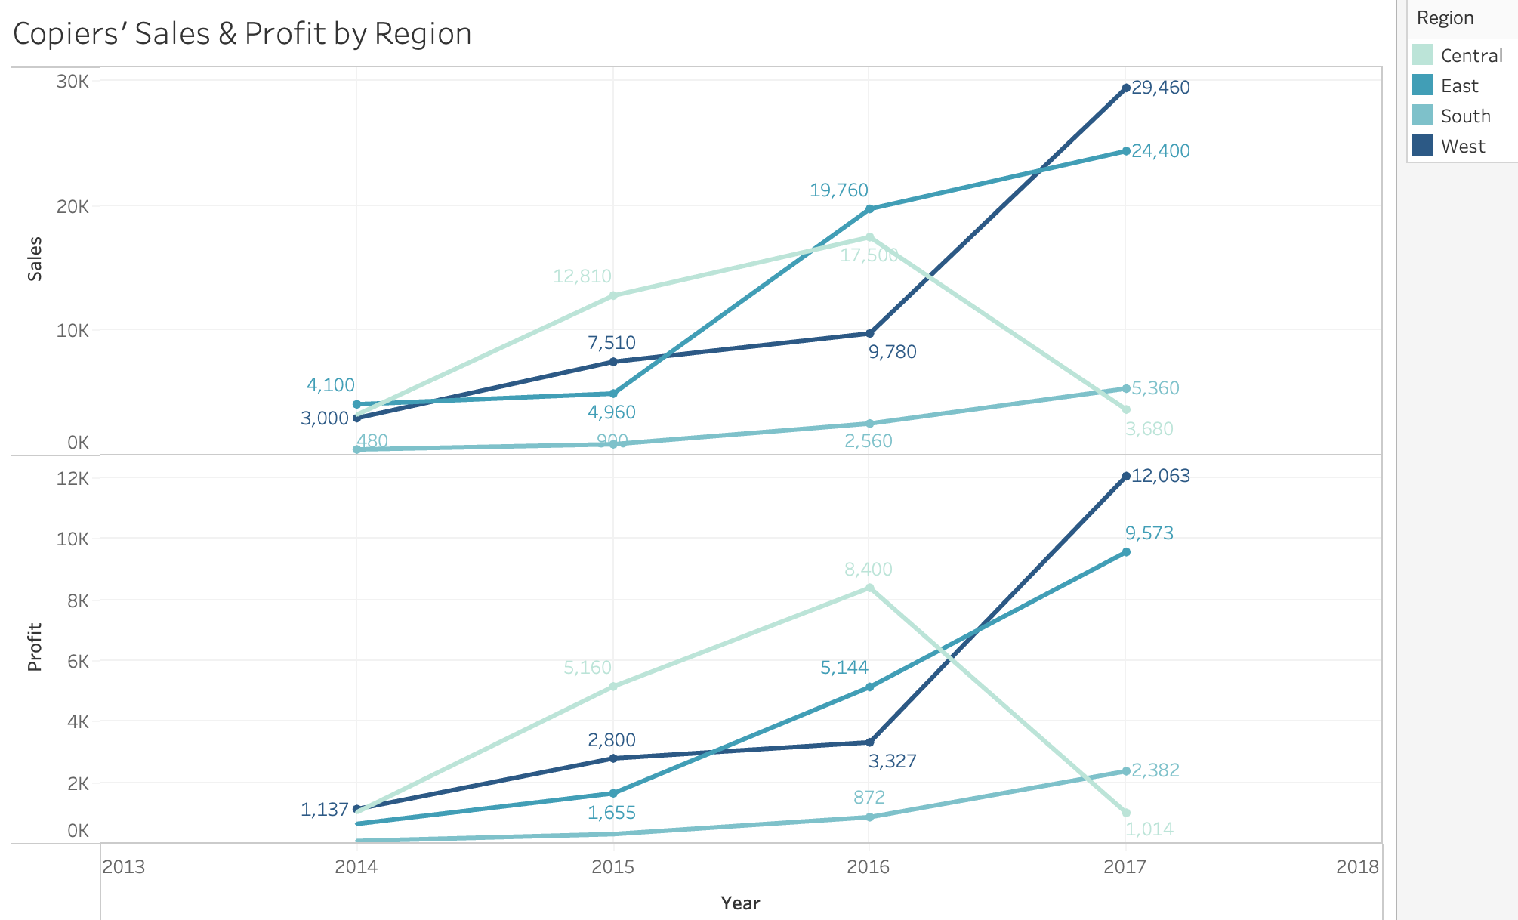
West and East: The main markets for Copiers with the highest sales and profits.
Central: potential but unstable market.
South: Although the sales and profits are the lowest, there are times of good growth.
We will categorise the regions into two groups: high-sales regions (East and West) and low-sales regions (Central and South).
12

Slide 13
Copiers’ High-Sales Regions Analysis
13

Slide 14
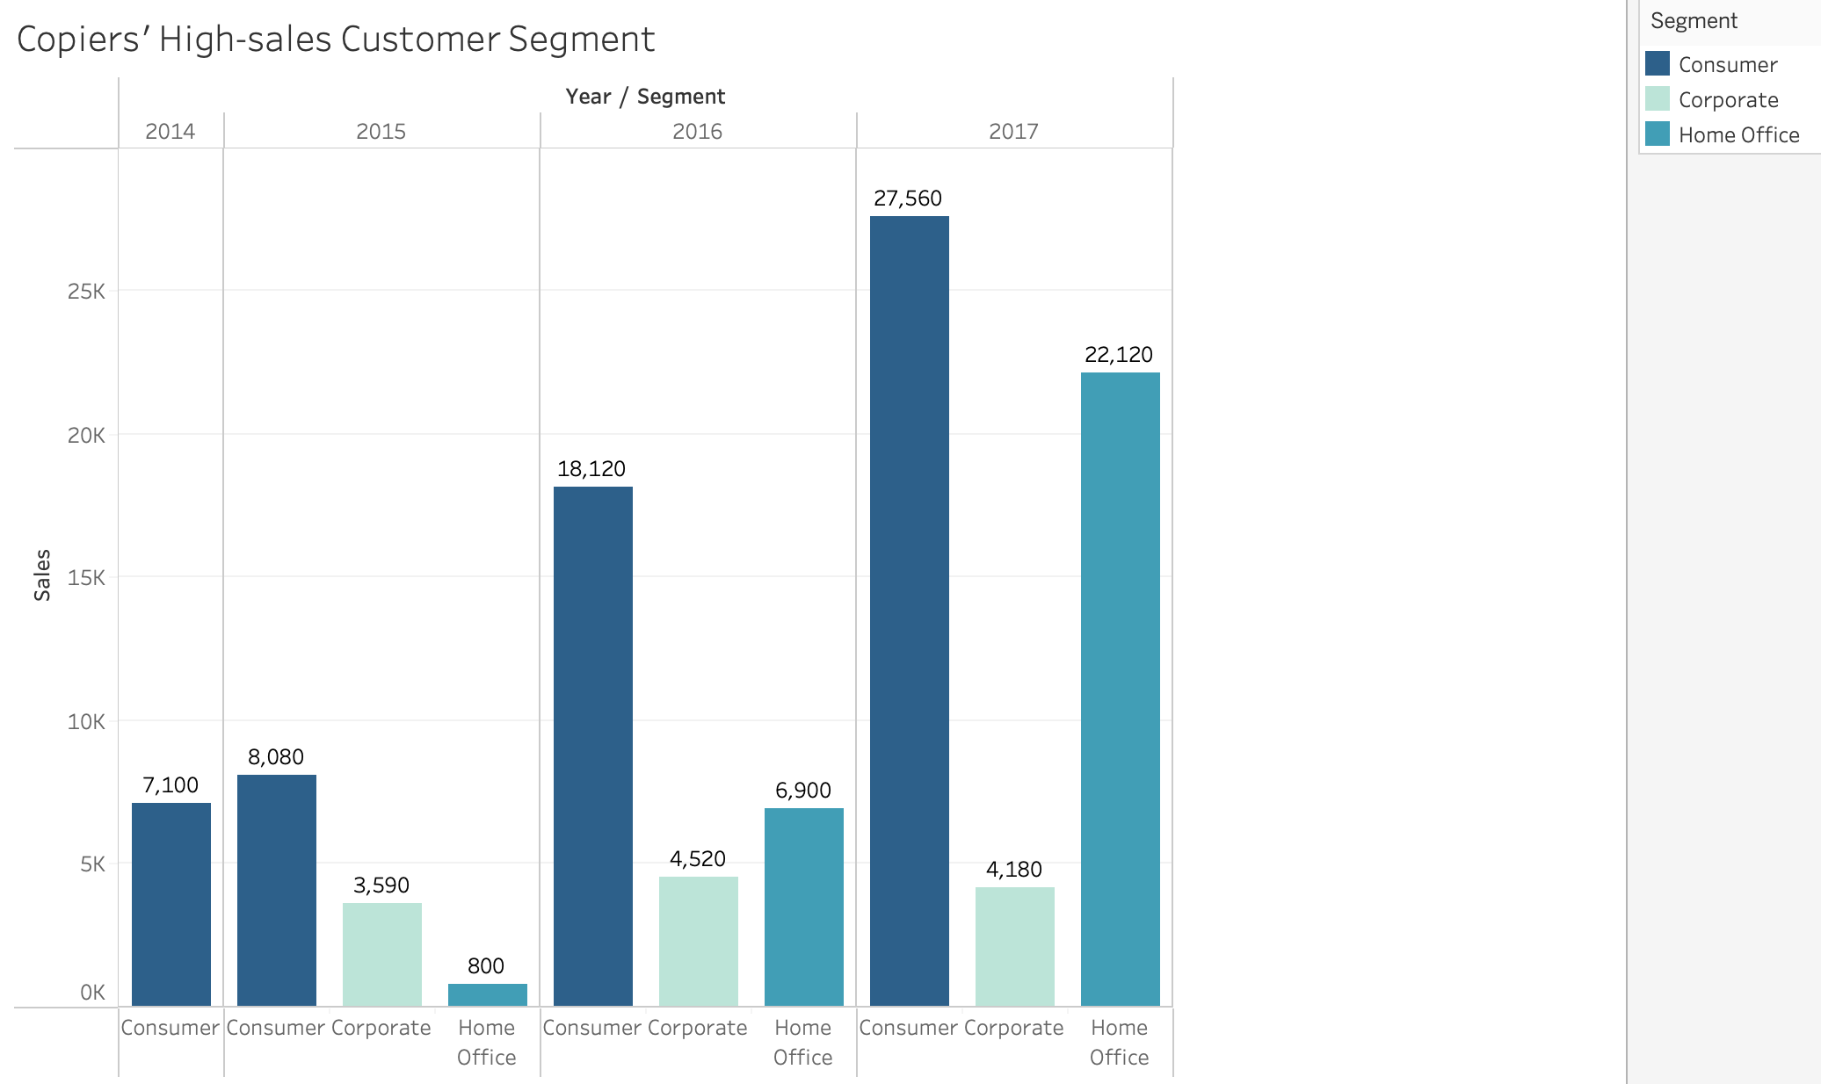
Consumer and Home Office are the two main customer segments that generate high revenue in high-sales regions.
14

Slide 15
76% of Venture Capital money in 2017
According to the National Venture Capital Association:
was concentrated in Silicon Valley (California), New York City (New York), and Boston (Massachusetts)
High demand for Copiers among home office and small business segments in West and East regions
(Forbes, 2018)
15
Notes:
Sự tập trung cao độ của vốn đầu tư mạo hiểm (VC) tại các trung tâm khởi nghiệp truyền thống như Thung lũng Silicon, Thành phố New York và Boston có nghĩa là những khu vực này thu hút một lượng lớn các công ty khởi nghiệp, doanh nhân và người làm nghề tự do, nhiều người trong số họ hoạt động từ các thiết lập văn phòng nhỏ hơn, linh hoạt hơn, bao gồm cả văn phòng tại nhà. Xu hướng này có thể trực tiếp thúc đẩy nhu cầu về thiết bị văn phòng như máy photocopy trong các phân khúc văn phòng tại nhà và doanh nghiệp nhỏ ở những khu vực này.

Slide 16
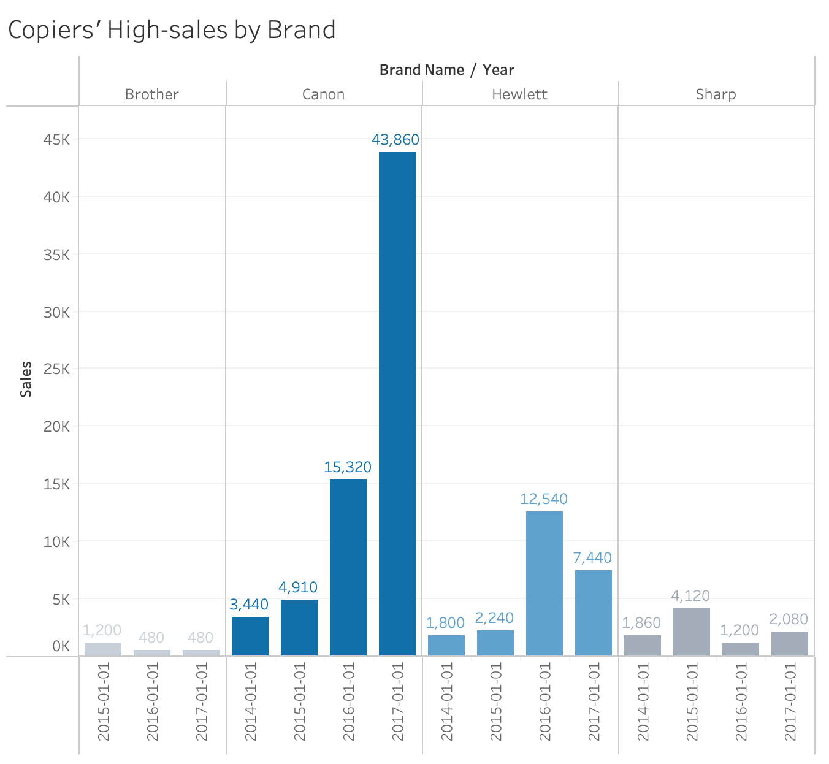
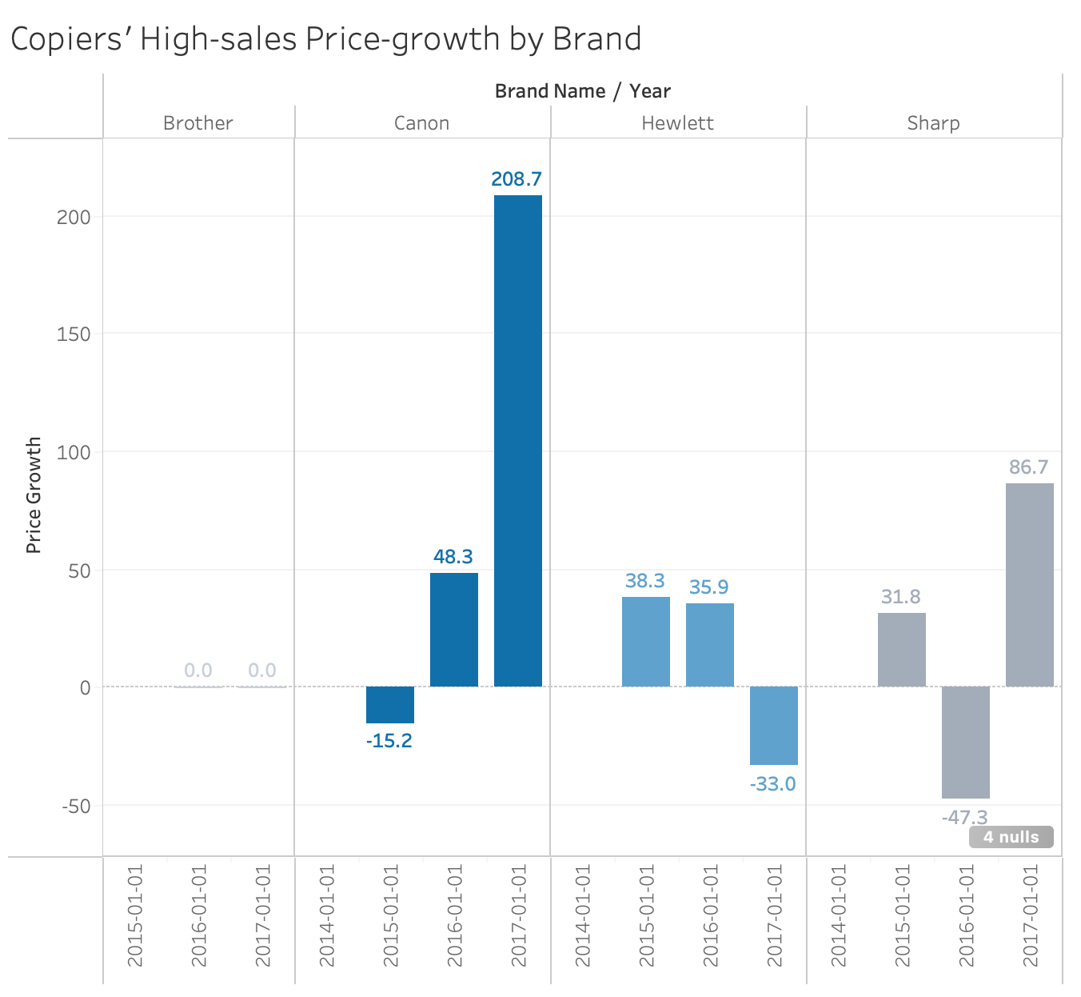
Canon is the top-selling brand, showing substantial sales growth. Hewlett Packard (HP) ranks second, showing strong growth in 2016 but experiencing a slight decrease in 2017. The Sharp and Brother brands, however, are less favoured in the Consumer and Home Office segments within the West and East regions.
16

Slide 17
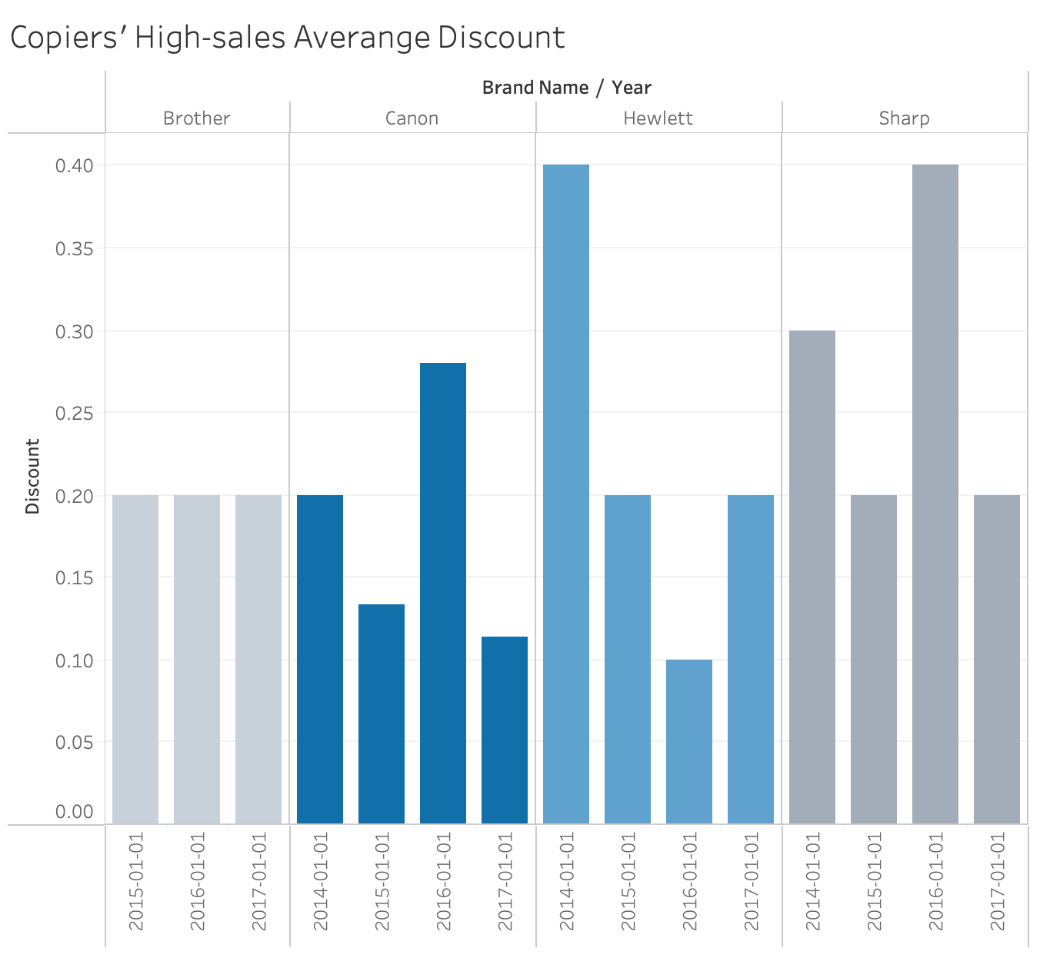
There appears to be a clear inverse relationship between discount rates and sales.
Canon is a highly recognised brand that generates significant revenue for the business. Its main customers are in the Consumer and Home Office segments, who are less concerned about price and discounts.
17

Slide 18
Copiers’ Low-Sales Regions Analysis
18

Slide 19
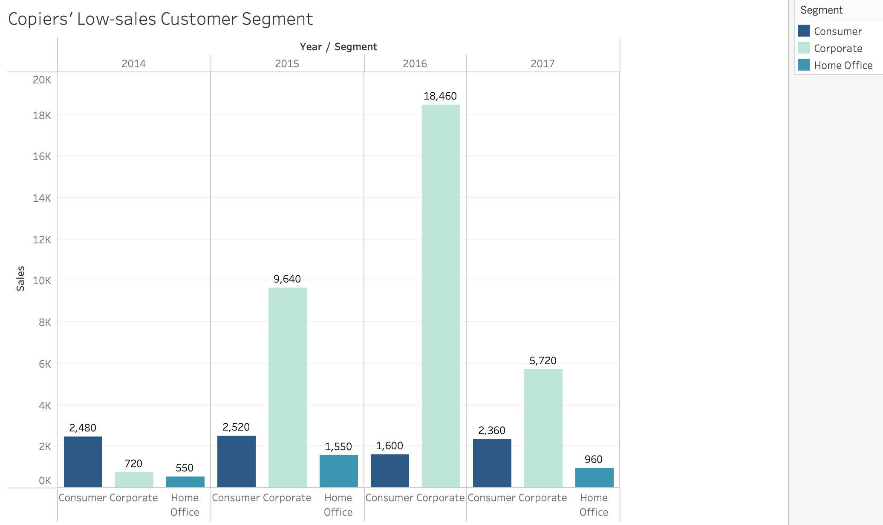
Corporate: consistently had the highest copier sales compared to the Consumer and Home Office segments. This indicates a strong demand for copiers in corporate environments. However, sales saw a slight decline in 2017.
Corporate is the main customer segments that generate high revenue in low-sales regions.
19

Slide 20
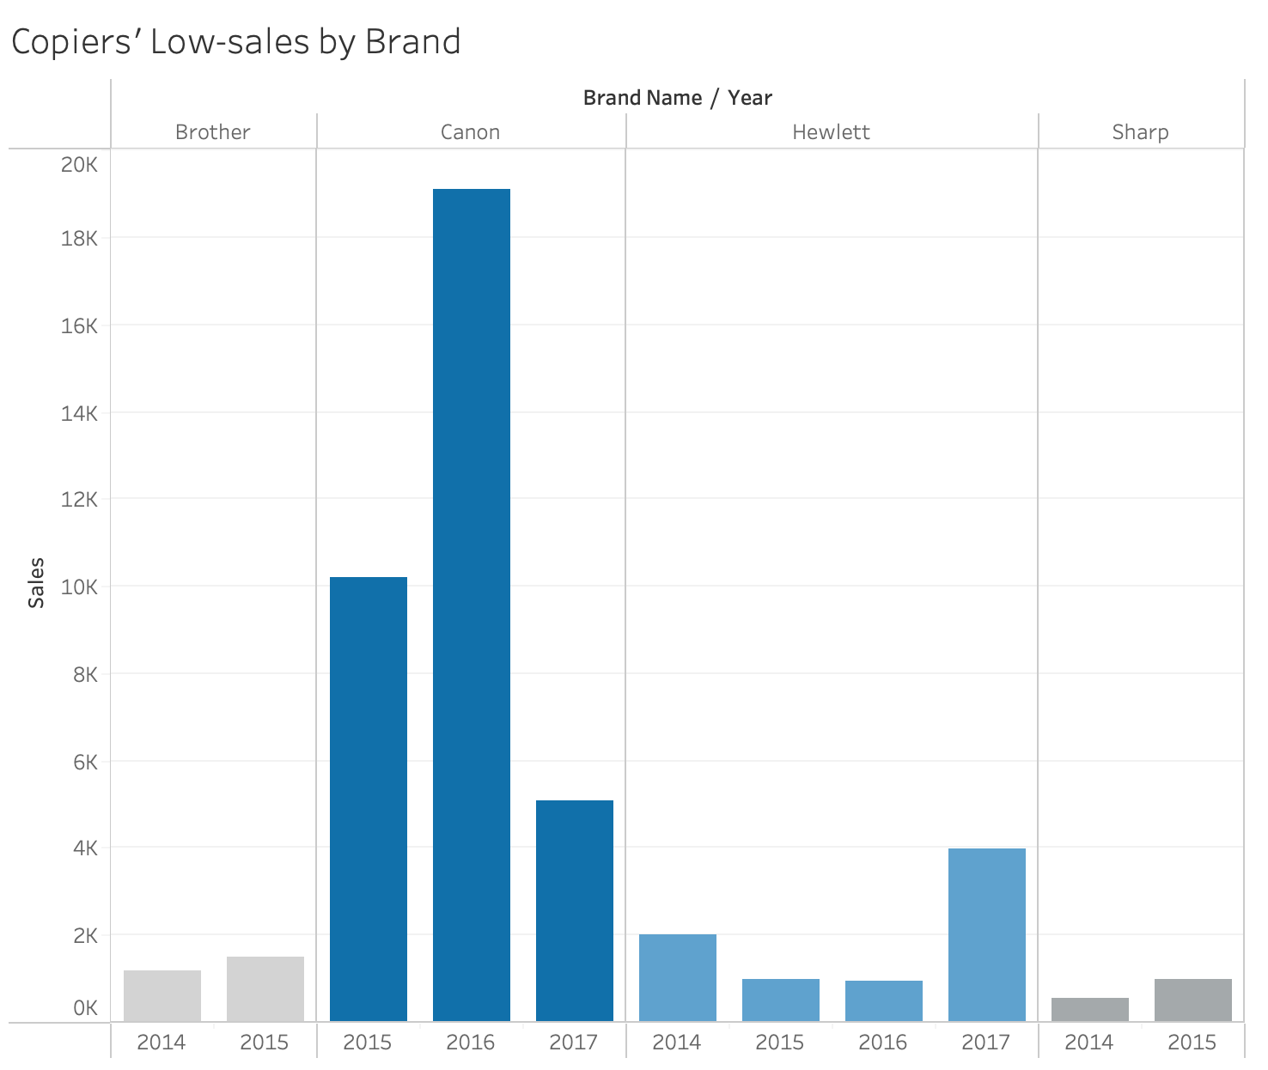
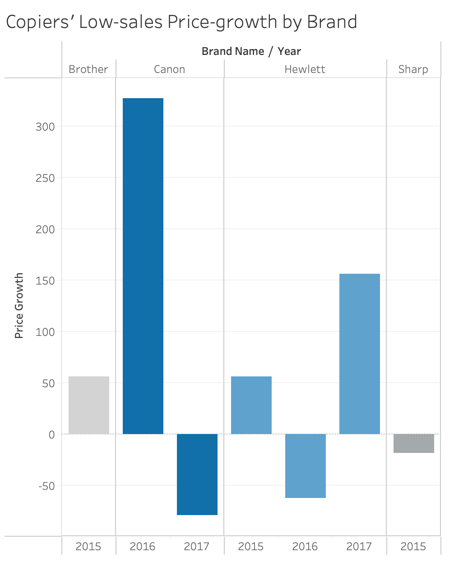
Canon remained the best-selling copier brand in the low-sales regions from 2015 to 2017, especially in 2016, with outstanding sales. Additionally, Hewlett-Packard (HP) showed strong growth from 2016 to 2017. Besides, Sharp and Brother have withdrawn from the market since 2016, indicating the fierce competition within the industry in low-sales regions.
20

Slide 21
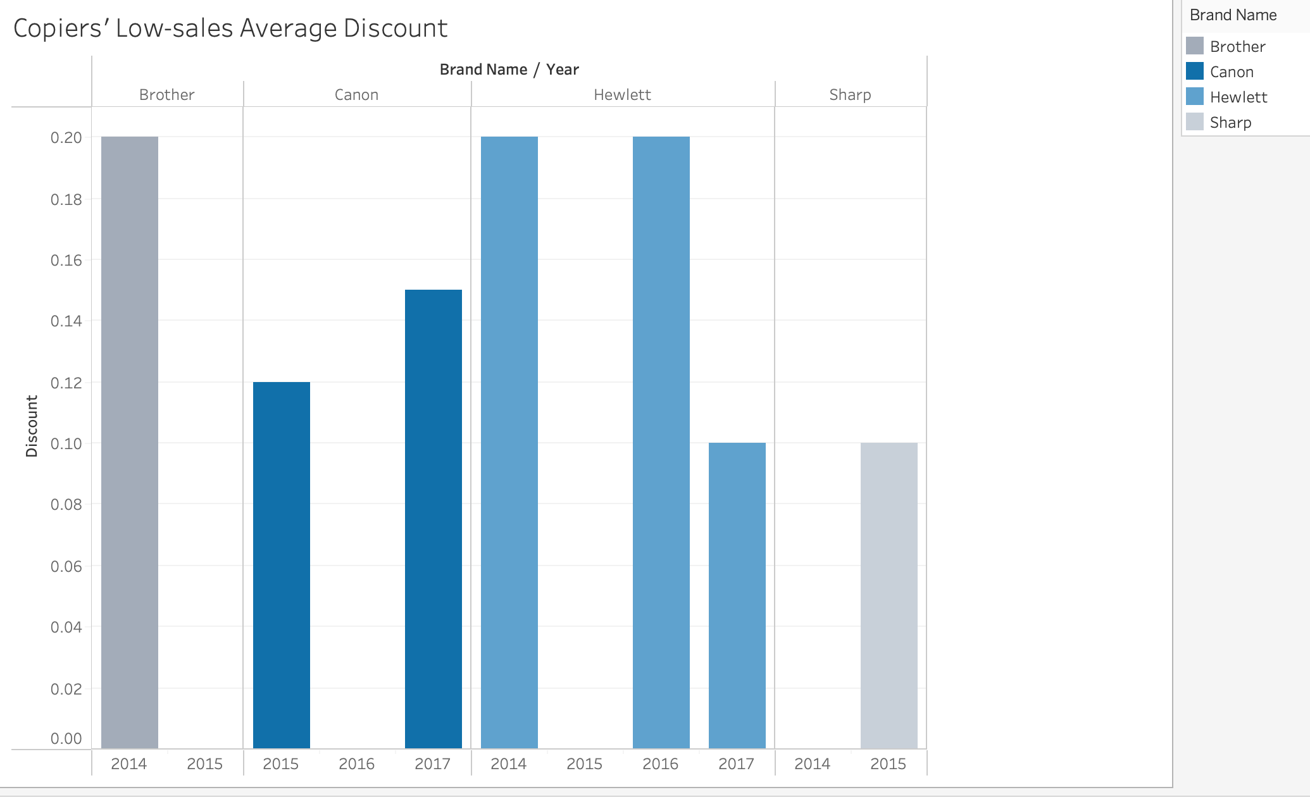
Although both Canon and HP raised prices in 2016 and 2017, respectively, this did not impact the sales. Even discount is not the reason impacting the sales and profit in low-sales regions.
21

Slide 22

RECOMMENDATIONS
22

Slide 23
Key Insights Summary
1. High Profitability of Copier Products: Copiers are a special product line, distinct from FMCGs, with a long lifecycle, high investment value, and substantial profit margins.
2. East and West Regions (High Revenue):
Main Customers: Consumer and Home Office segments, with Home Office showing strong growth potential.
Pricing Insensitivity: Sales growth remains strong even when prices rise or discounts are reduced.
Brand Dynamics: Canon dominates the Copier market, followed by HP, Sharp, and Brother.
3. South and Central Regions (Lower Revenue):
Main Customers: Corporate segment, but with fluctuating and declining growth.
Pricing Insensitivity: Similar to other regions, Corporate consumers are not sensitive to pricing or discounts.
Brand Competition: Canon and HP have emerged as the primary competitors in the Copier market from 2016 onward.
23

Slide 24
Recommendations
Focus on High Revenue Areas (East and West):
Prioritise Home Office Segment: Promote high-end Copiers from Canon and HP with features like fast printing, compact design, and mobile connectivity.
Create Bundle Offers: Develop bundle deals that include Copiers along with consumables (paper, toner, office accessories) to increase order value and encourage repeat business.
2. Drive Growth in Low Revenue Areas (South and Central):
Financial Solutions: Implement flexible leasing or instalment payment options for Corporate customers to reduce initial investment costs.
Upgrade Policy: Offer trade-in programs where customers can exchange old machines for new ones at discounted prices, with ongoing maintenance support.
24

Slide 25
Recommendations
3. Enhance After-Sales Services:
Premium Services: Create premium service packages with priority hotlines and fast technical support to add value and build customer loyalty.
4. Build Long-Term Customer Relationships:
Loyalty Program: Develop a loyalty program for Copier customers with exclusive offers on consumables, maintenance packages, and periodic gifts.
25

Slide 26
THANK YOU FOR LISTENING!
Do you have any questions?
26

